Slide 1
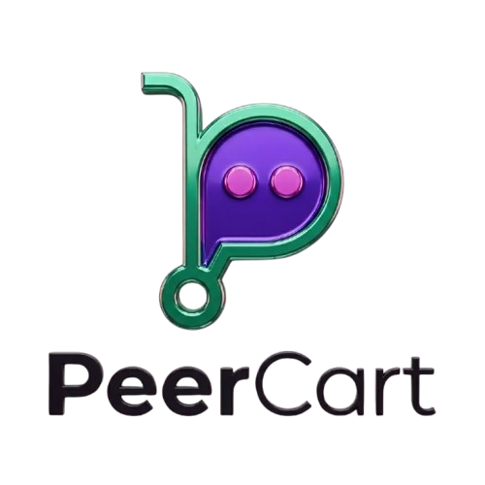
School of Computer Science & Engineering
AI Application Development – IA1
Buy • Sell • Rent

Slide 2
Team Members and Roles
Name | Role
Thomson Sunny | Team Lead
Sujal Patil | Development Lead and Test Lead
Shreyas Reddy | Marketing Lead
Shivarayagouda Biradar | Customer Contact Lead
Notes:
Talk about how they are managing their documents, how google docs does automatic versioning
As them what they know about Android and IoS versions

Slide 3
Problem Statement
Users face difficulty in buying and selling second-hand items due to lack of trust, fake users, and unorganized platforms.
Finding reliable buyers or sellers is time-consuming and inefficient in existing systems.
Notes:
Talk about how they are managing their documents, how google docs does automatic versioning
As them what they know about Android and IoS versions

Slide 4
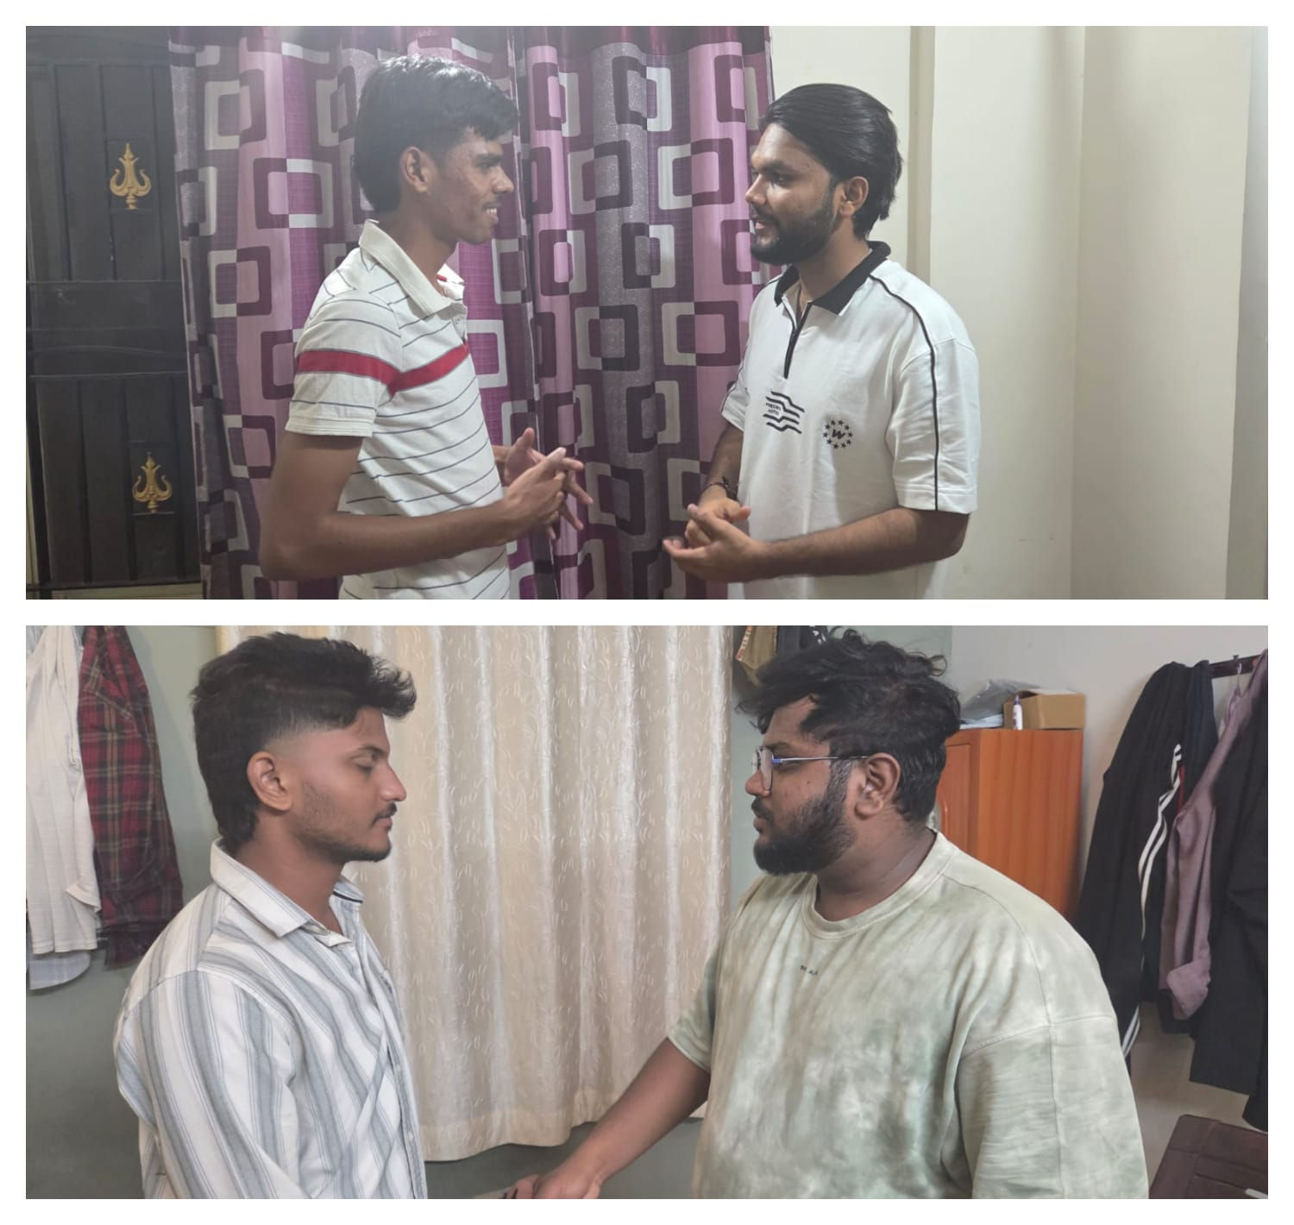
User or Customer Understanding
Interview Questions Asked:
What challenges do you face while buying or selling second-hand items?
Do you trust existing platforms for peer-to-peer transactions? Why or why not?
Would you prefer renting items instead of buying for short-term use?
Would you use a verified platform where users are authenticated?
Key Findings:
~75–80% users reported trust issues (fake users/scams)
~70% said finding buyers/sellers is time-consuming
~60–65% showed interest in renting items
~85–90% said they would use a verified marketplace like PeerCart
Detailed interview records available in GitHub
Notes:
Talk about how they are managing their documents, how google docs does automatic versioning
As them what they know about Android and IoS versions

Slide 5
Ideal Customer Profile (ICP)
1. Demographic Profile
Age: 18–30 years
Occupation: Students, young professionals, freelancers
Location: Urban & semi-urban areas
Living Situation: Hostel, PG, rented apartments
Income Level: Budget-conscious / limited disposable income
2. Psychographic Profile
Values saving money and smart spending.
Prefers convenience and quick solutions.
Concerned about trust and safety in online transactions.
Open to second-hand usage and renting.
Comfortable using mobile apps and digital platforms.
PeerCart targets budget-conscious, tech-savvy users who seek a safe, convenient, and efficient way to buy, sell, and rent items.
Notes:
Only stress on the 1st sentence – the definition
Come back to the 2nd sentence in the end as part of revision

Slide 6

Customer Persona (CP)
Srujan L, 21 — Student, Bengaluru
Who He Is
3rd-year B.Tech student at REVA University, lives in a hostel, tech-savvy, budget-conscious, frequently buys and sells used items
His Problem
Relies on WhatsApp groups, friends, and apps like OLX, but everything is scattered, unorganized, and lacks trust.
His Pain
Wastes hours searching for the right buyer or seller
Constant fear of fake users and scams
No option to rent items for short-term needs
Too many platforms, no single trusted solution
What He Wants
A single trusted platform where he can buy, sell, or rent items easily, connect with verified nearby users, and complete transactions quickly with confidence.
Notes:
Only stress on the 1st sentence – the definition
Come back to the 2nd sentence in the end as part of revision

Slide 7
Product USP
Why Will Customers Use PeerCart?
Safe transactions with verified users
Saves time with quick buyer/seller matching
Ability to rent items instead of buying
Convenient all-in-one platform (no need for multiple apps)
Helps users save and earn money easily
What is Unique About PeerCart?
Trust-first approach with user verification and ratings
Buy • Sell • Rent in one platform.
“Post Your Need” feature (demand-based matching)
AI-powered price suggestions & smart search
Nearby user matching for faster transactions
How is it Different from Existing Platforms?
No strong trust system → Verified users & trust scores
Only buying/selling → Includes renting
Manual search → Smart matching + need-based posting
Unorganized listings → Structured and user-friendly system
Slow transactions → Faster, location-based connections
PeerCart combines trust, convenience, and smart matching to create a faster and safer peer-to-peer marketplace.
Notes:
Only stress on the 1st sentence – the definition
Come back to the 2nd sentence in the end as part of revision

Slide 8
Use Cases & High Level Requirements
Use Cases – How Users Interact with PeerCart
Sell an Item
Input: Item details (name, price, category, location)
Output: Item listed → matched with potential buyers.
2. Buy an Item
Input: Search/query or browse items
Output: Relevant listings + nearby sellers.
3. Rent an Item
Input: Item requirement + duration
Output: Available rental options nearby
4. Post a Need
Input: “I need [item]” request
Output: Sellers get notified and respond
5. User Verification & Trust
Input: Email/phone verification + user details
Output: Verified badge + trust score displayed
High-Level Requirements
Functional Requirements
User registration & login
Add / view / manage listings
Search and filter items
Rent, buy, sell functionality
User verification & rating system
“Post your need” feature
Non-Functional Requirements
Fast response time and easy to use interface
Secure user data & authentication
Scalable for large number of users
Reliable system performance
Acceptance Criteria
Users can successfully list and view items
Only verified users can interact fully
System shows relevant results based on input
Transactions/interactions are smooth and error-free
Notes:
Only stress on the 1st sentence – the definition
Come back to the 2nd sentence in the end as part of revision

Slide 9
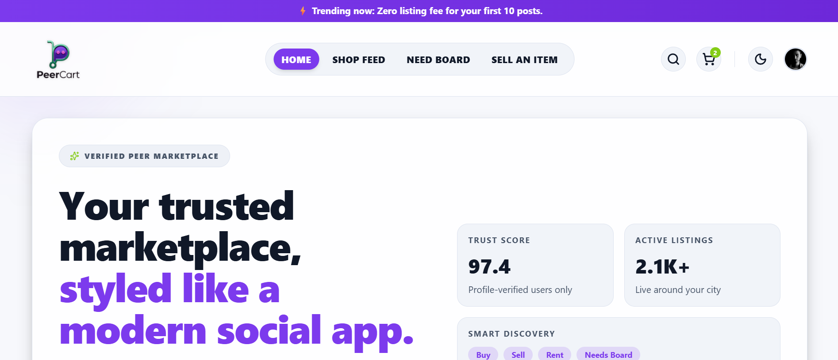
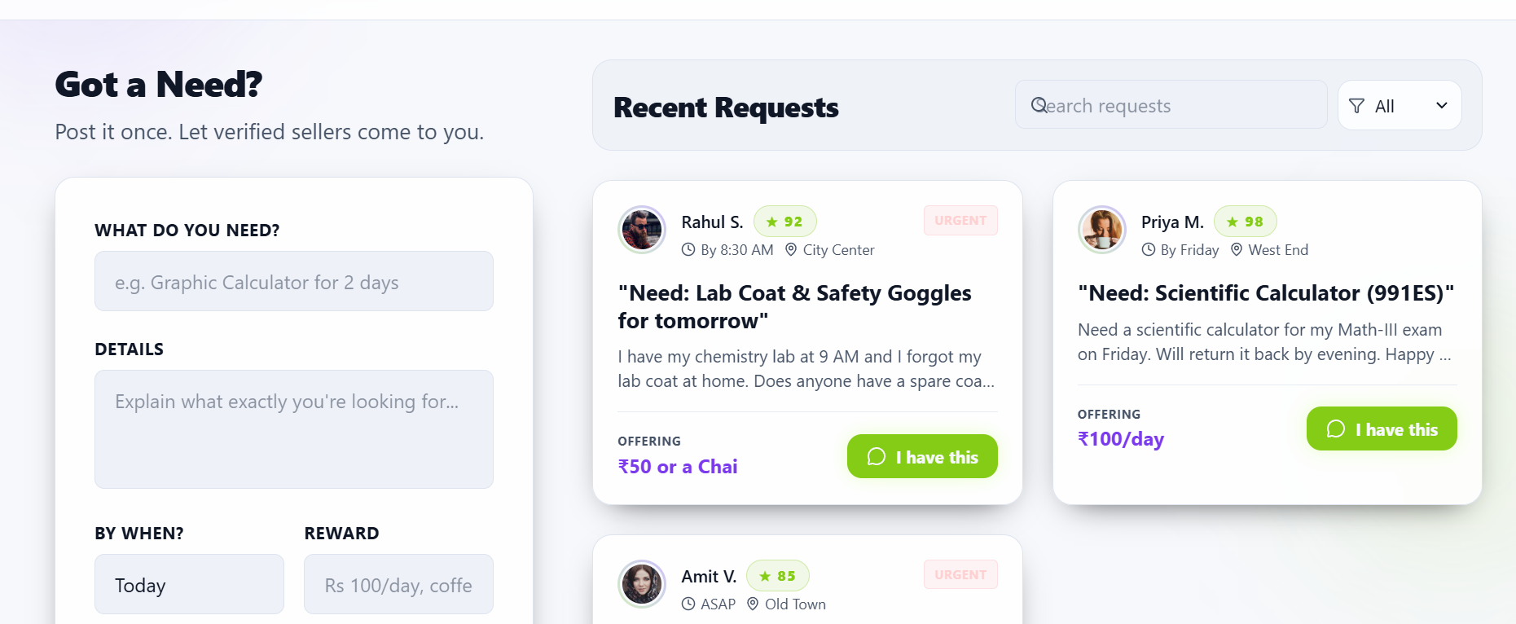
Proof of Concept (PoC) / Prototype Demo
Notes:
Only stress on the 1st sentence – the definition
Come back to the 2nd sentence in the end as part of revision

Slide 10
Thank You

